Slide 1
TCP/IP Network Fundamentals
UEEN2013/UEEN2432
(Topic 04)
Basic Routing

Slide 2
(A) Router
The basic purpose of a router
Computers that specialize in sending packets over the data network.
They are responsible for interconnecting networks by selecting the best path for a packet to travel and forwarding packets to their destination

Slide 3
Hardware Component of a Cisco Router
Router components and their functions”
CPU - Executes operating system instructions
Random access memory (RAM) - Contains the running copy of configuration file. Stores routing table. RAM contents lost when power is off
Read-only memory (ROM) - Holds diagnostic software used when router is powered up. Stores the router’s bootstrap program.
Non-volatile RAM (NVRAM) - Stores startup configuration. This may include IP addresses (Routing protocol, Hostname of router)
Flash memory - Contains the operating system (Cisco IOS)
Interfaces - There exist multiple physical interfaces that are used to connect network. Examples of interface types:
Ethernet / fast Ethernet interfaces
Serial interfaces
Management interfaces

Slide 4
Cisco IOS
Similar to a personal computer, a router cannot function without an operating system.
The Cisco Internetwork Operating System (IOS) is the system software in Cisco devices.
The Cisco IOS provides devices with the following network services:
Basic routing functions
Reliable and secure access to networked resources
Network scalability

Slide 5
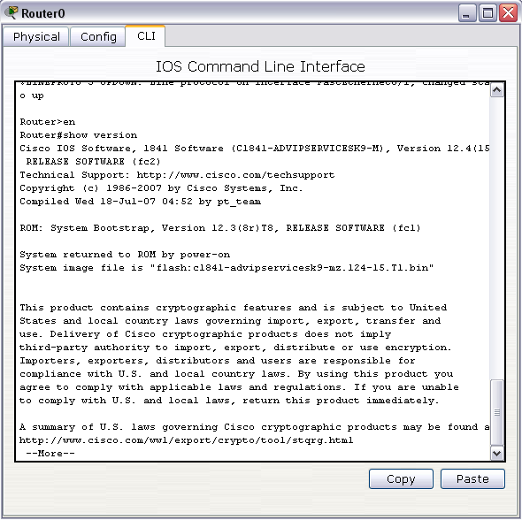
Command Line Interface (CLI)
The services provided by the Cisco IOS are generally accessed using a command line interface (CLI).
CLI is the “place” where you put in the commands in order to perform the router configuration such as:
Setting IP address for router ports.
Setting routes
Showing routers statistics

Slide 6
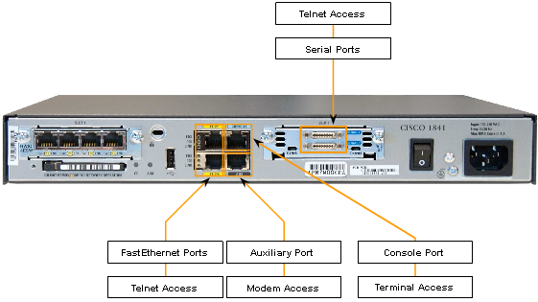
Accessing CLI
There are 3 ways to access the CLI environment.
Console
Telnet or SSH
AUX port

Slide 7
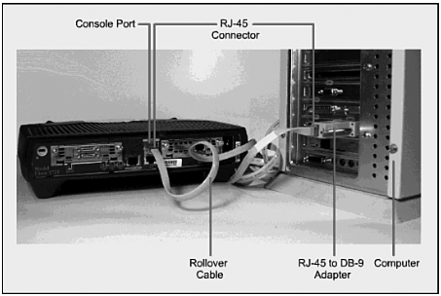
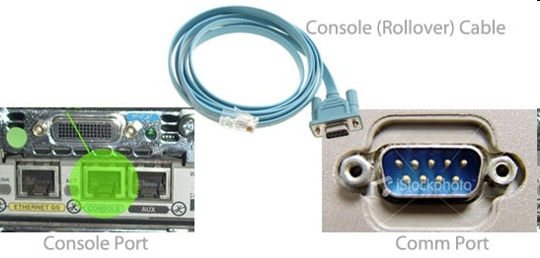
Accessing CLI – Console port
You need 2 items + 1 software to access the CLI via the console port
PC,
Rollover Cable
Comm software (e.g. HyperTerminal),
Rollover cable is a cable with a serial comm connect at one end, and a RJ-45 connector at the other end.
Rollover connects the serial comm port of a PC to the console port of a router.

Slide 8
Accessing CLI – Console port
The console port is often used to access a router
when the networking services have not been started or have failed.
When a router is first placed into service, networking parameters have not yet been configured yet.
The initial configuration of the network device
Disaster recovery procedures and troubleshooting where remote access is not possible
Password recovery procedures
Accessing CLI through console port can’t be done remotely (from a far)
One has to be done next to the router with a PC/laptop

Slide 9

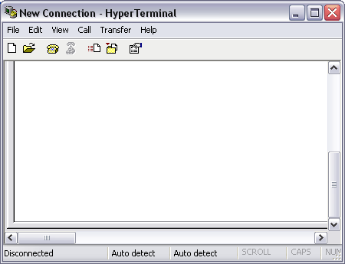
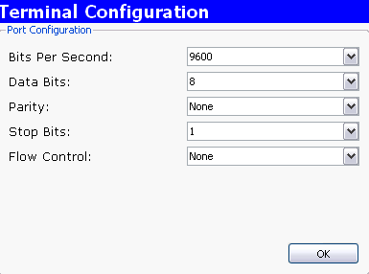
Accessing CLI – Console port
HyperTerminal in Windows XP is the software that you can use to access the CLI environment.
You can set the HyperTerminal Configuration as shown

Slide 10
No DHCP or Data via Console
Rollover cable via console port is NOT for network purposes, hence for PC0:
don’t need an IP to perform configuration
can’t obtain DHCP or dynamic IP
can’t access web pages
can’t download files
can’t access any network services
Rollover cable

Slide 11
Accessing CLI Remotely – Telnet & Aux
Two ways to access CLI for “afar” or remotely:
Aux port
via a telephone dialup connection using a modem connected to the router's AUX port.
Similar to the console connection, this method does not require any networking services to be configured or available on the device.
The AUX port can also be used locally, like the console port, with a direct connection to a computer running a terminal emulation program.
telnet
via the networking ports (FastEthernet Ports: e.g. fa0/0, Ethernet ports, serial ports).
Telnet service has to be setup via the console port first.
Telnet
Telnet
Aux
Telnet

Slide 12
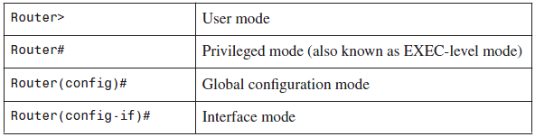
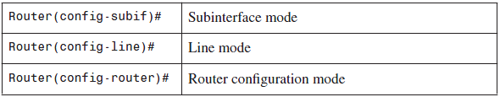
Router CLI mode
CLI mode = prompt
Different mode accepts different set of commands
Just remember= different prompt cater for different commands

Slide 13
User and Privileged Mode
User mode can only access limited commands
Prompt ‘>’
Can use “show” commands
Can’t make configuration which changes the router.
Privilege mode is where you can enter commands that can configure the router
Prompt ‘#’
Only after the command “enable” you can start to enter other commands that can make changes to the router.

Slide 14
Right Command at the right prompt
You have to be in the right “prompt” before a command can be “accepted”.
In router CLI, not only you need to memorize the commands (and their effect), but also the “correct prompt” that you key in the command.
So beware of the prompt (or CLI mode) when you configure the Cisco router.
Router>int fa0/0
^
% Invalid input detected at '^' marker.
Router>en
Router#int fa0/0
^
% Invalid input detected at '^' marker.
Router#conf t
Enter configuration commands, one per line. End with CNTL/Z.
Router(config)#int fa0/0
Router(config-if)#
Commands
at the “wrong”
prompt.

Slide 15
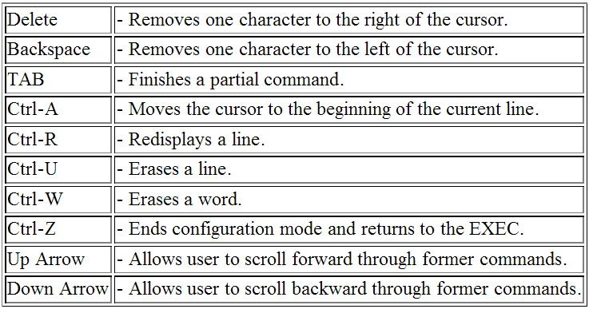
Router Commands Hot-Keys

Slide 16
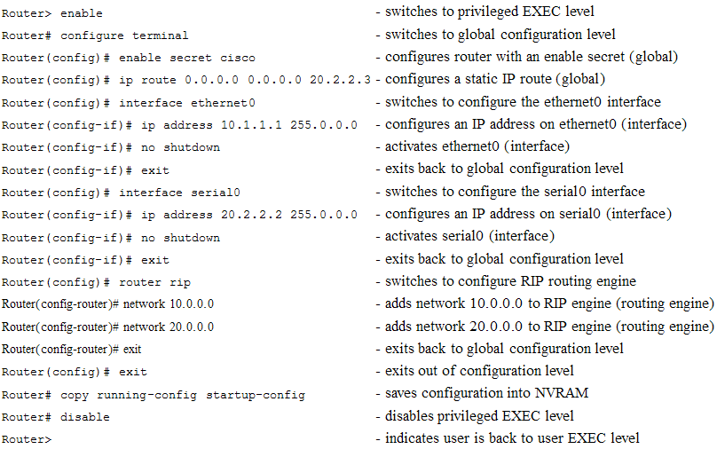
Some Examples of Cisco Commands

Slide 17
Turn on Telnet Service with Password
In order for you to “remotely” telnet into the router via the data ports (e.g. fa0/0)
The following shows the commands that turn on the telnet service of the router.
vty = ( Virtual TeletYpe), treat this as telnet
0 4 = accepting channel 0 to channel 4, concurrently 5 telnet users can log in.
uccn1003#conf t
uccn1003(config)#line vty 0 4
uccn1003(config-line)#password <password>
uccn1003(config-line)#login
uccn1003(config-line)#end
uccn1003#

Slide 18
Running-configuration
Choo#show run
Building configuration...
!
version 12.4
!
hostname Choo
!
enable password uccn1003
interface FastEthernet0/0
ip address 192.168.1.254 255.255.255.0
!
interface FastEthernet0/1
no ip address
shutdown
!
interface Vlan1
no ip address
shutdown
!
line con 0
line vty 0 4
password network
login
!
end
Choo#
The active configuration file of the router.
Stored in RAM
If the power is turned-off, the running-configuration will be GONE.
Command “show run”.
You need to view the running-config in order to troubleshoot the router.

Slide 19
Startup-configuration
Stored in NVRAM.
Load in as running-config during the router startup.
Command for viewing the startup-config: “show start”
Backing up running-config in startup-config: “copy run start”
Note, when you turn off switches or routers and then turn them back on, they will load their startup configuration files.
If you do not backup the running configuration, it will be lost.
Choo#show start
startup-config is not present
Choo#copy run start
Destination filename [startup-config]?
Building configuration...
[OK]
Choo#show start
Using 508 bytes
!
version 12.4
!
hostname Choo
!
enable password uccn1003
!
interface FastEthernet0/0
ip address 192.168.1.254 255.255.255.0
!
interface FastEthernet0/1
no ip address
shutdown
!
end

Slide 20
Voiding or Canceling commands
To remove a command from the configuration, simply go to the proper location or prompt and type "no" followed by the command to be removed.
The following example show
How to remove hostname
How to remove enable password
How to remove an IP address in int fa0/0
Please compare the running-config on the right, with the running-config at the previous two slides.
Router#show run
Building configuration...
!
version 12.4
!
hostname Router
!
interface FastEthernet0/0
no ip address
!
interface FastEthernet0/1
no ip address
shutdown
!
line con 0
line vty 0 4
password network
login
!
end
Choo#
Choo#conf t
Choo(config)#no hostname Choo
Router(config)#no enable password
Router(config)#int fa0/0
Router(config-if)#no ip address
Router(config-if)#

Slide 21
Conclusion
You have been shown the basic overview of Cisco Router
Cisco CLI and how to access it
Console port and rollover cables
CLI modes and prompts
Some simple cisco commands
Running-config & startup-config.

Slide 22
(B) Introuction to Routing

Slide 23
Introduction to Routing
Routing is the process of “directing” data from one IP interface on a network to another IP interface on another network.
Routing works with IP address
does NOT work with port number or MAC address
Routing needs two things:
Data containing IP address (especially destination IP)
Routing Table in Routers.
Routing has to function on scalable network.
Scalable means the network is constantly growing or contracting.

Slide 24
Routing Process in Router
A router must perform the following steps while making routing decision:
The router receive data (with IP address, both source IP and destination IP) from an interface.
The router then checks destination IP of the data to see if the destination network address exists in its routing table.
If Yes: From the routing table, the router determines which interface to use to forward the packet.
If no, the router will discard the packet and send an ICMP destination network unreachable message to the source of the packet.
The packet continues this process until it reaches its destination.

Slide 25

Forwarding
A router MUST have the capability to forward a packet.
Definition of Forwarding:
Placing a packet from a inbound interface to a outbound interface.
Data being forwarded,
will travel to the gateway
(interface of another router)
Data comes
in through
this port.
Router “forwards”
the data to the outbound port

Slide 26
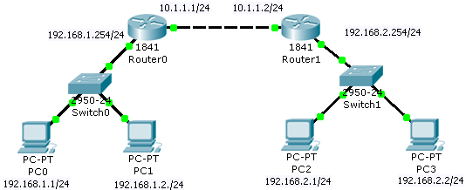
IP Routing Rule #1
If there are 2 or more routers in a network, you need to configure routes in the routers.

Slide 27
Checking Routing Table in Cisco
The command to check routing table in cisco
#show ip route or #sh ip ro

Slide 28
IP Routing Rule #2
Routes can be set using static routes or dynamic routes.
Static routes are set manually by network administrator.
Dynamic routes are set by software, routing protocol software.

Slide 29
Setting Static Routes - 1
PC0 can ping
192.168.1.254
10.1.1.1
However, PC0 can’t ping
192.168.2.1
10.1.1.2
Why?

Slide 30
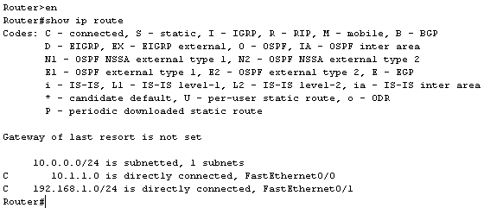
Setting Static Routes - 2
The routing table of Router0
Router0 only knows the two neighboring subnets that are connected to it.
192.168.1.0/24 and 10.1.1.0/24
Router0 does not know the existence of network 192.168.2.0/24
We need to set a route in Router0 to point to 192.168.2.0/24
C = connected

Slide 31
Setting Static Routes - 3
Destination network
gateway
Router0#conf t
Router0(config)#ip route 192.168.2.0 255.255.255.0 10.1.1.2
Router0(config)#
Syntax of static route
Router(config)#ip route destination_network subnet_mask gateway_IP

Slide 32
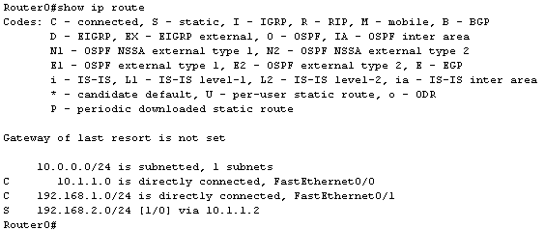
Setting Static Routes - 4
After the “ip route” command, Router0 knows the existence of 192.168.2.0/24 via gateway IP 10.1.1.2

Slide 33
Setting Static Routes - 5
gateway
Destination network
Router1#conf t
Router1(config)#ip route 192.168.1.0 255.255.255.0 10.1.1.1
Router1(config)#

Slide 34
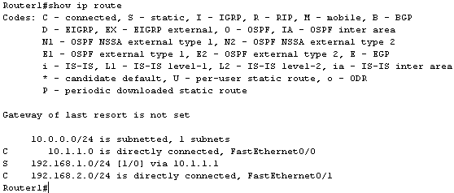
Setting Static Routes - 6
After the ip route command, Router1 knows the existence of 192.168.1.0/24 via gateway IP 10.1.1.1

Slide 35
Setting Dynamic Routes – RIP
Setting dynamic routes with RIP (routing information protocol).
Router1(config)#router rip
Router1(config-router)#network 192.168.2.0
Router1(config-router)#network 10.1.1.0
Router1(config-router)#exit
Router1(config)#
Router0(config)#router rip
Router0(config-router)#network 192.168.1.0
Router0(config-router)#network 10.1.1.0
Router0(config-router)#exit
Router0(config)#

Slide 36
Setting Dynamic Routes - RIP
Routing tables of two routes with dynamic routes.
10.0.0.0/24 is subnetted, 1 subnets
C 10.1.1.0 is directly connected, FastEthernet0/0
C 192.168.1.0/24 is directly connected, FastEthernet0/1
R 192.168.2.0/24 [120/1] via 10.1.1.2, 00:00:25, FastEthernet0/0
10.0.0.0/24 is subnetted, 1 subnets
C 10.1.1.0 is directly connected, FastEthernet0/0
R 192.168.1.0/24 [120/1] via 10.1.1.1, 00:00:04, FastEthernet0/0
C 192.168.2.0/24 is directly connected, FastEthernet0/1

Slide 37
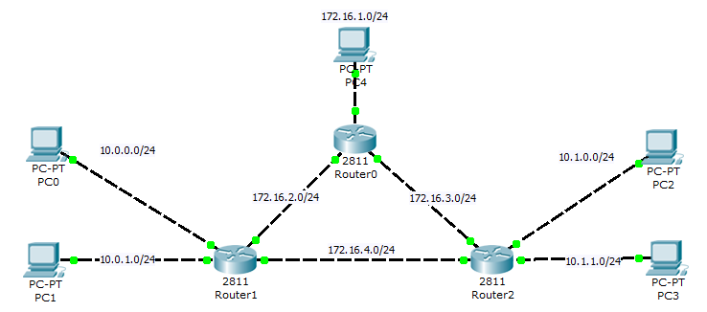
Setting Dynamic Routes - OSPF

Slide 38
Setting Dynamic Routes - OSPF
Router0:
router ospf 1
network 172.16.1.0 0.0.0.255 area 0
network 172.16.2.0 0.0.0.255 area 0
network 172.16.3.0 0.0.0.255 area 0
Router1:
router ospf 1
network 172.16.1.0 0.0.0.255 area 0
network 172.16.2.0 0.0.0.255 area 0
network 172.16.3.0 0.0.0.255 area 0
Router2:
router ospf 1
network 172.16.3.0 0.0.0.255 area 0
network 172.16.4.0 0.0.0.255 area 0
network 10.1.0.0 0.0.0.255 area 0
network 10.1.1.0 0.0.0.255 area 0

Slide 39
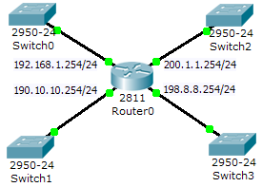
IP Routing Rule #3
In the routing table, the “connected” networks are shown when we configure the IP address for the router interfaces.
There are supposedly 4 subnets connected to Router0.
Why the routing table only shows 3 subnets?
Router#show ip route
…
190.10.0.0/24 is subnetted, 1 subnets
C 190.10.10.0 is directly connected, FastEthernet0/1
C 192.168.1.0/24 is directly connected, FastEthernet0/0
C 198.8.8.0/24 is directly connected, FastEthernet1/1

Slide 40
Commands for the previous example
Router(config)#int fa0/0
Router(config-if)#ip addr 192.168.1.254 255.255.255.0
Router(config-if)#no shut
Router(config-if)#int fa0/1
Router(config-if)#ip addr 190.10.10.254 255.255.255.0
Router(config-if)#no shut
Router(config-if)#int fa1/0
Router(config-if)#no shut
Router(config-if)#int fa1/1
Router(config-if)#ip addr 198.8.8.254 255.255.255.0
Router(config-if)#no shut
Fa1/0 is NOT set with an IP, thus the routing table does not show the subnet attached to it as “connected”
Though the interface is turn “on” with “no shut”
Router#show ip int br
Interface IP-Address OK? Method Status Protocol
FastEthernet0/0 192.168.1.254 YES manual up up
FastEthernet0/1 190.10.10.254 YES manual up up
FastEthernet1/0 unassigned YES unset up up
FastEthernet1/1 198.8.8.254 YES manual up up

Slide 41
IP Routing Rule #4: Default Route
Router(config)#ip route 0.0.0.0 0.0.0.0 gateway_IP
Default route is the gateway of last resort. If destination IP can’t find a matching destination network in the routing table, the data will go the way of default route
Default route is a special static route.
It is similar in concept to default gateway.
Command in Cisco router:
Apply default route smartly, you can save a lot of work.

Slide 42
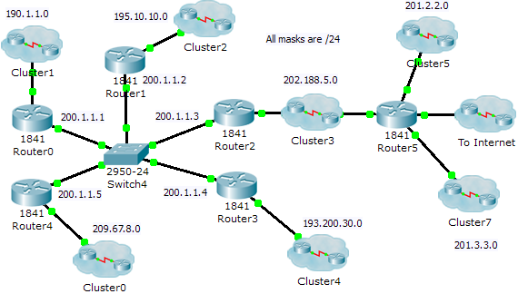
Example of Applying Default Route - 1
Question:
How do we set static routes in Router4 for this network?

Slide 43
Example of Applying Default Route - 2
Router4(config)#ip route 190.1.1.0 255.255.255.0 200.1.1.1
Router4(config)#ip route 195.10.10.0 255.255.255.0 200.1.1.2
Router4(config)#ip route 202.188.5.0 255.255.255.0 200.1.1.3
Router4(config)#ip route 201.2.2.0 255.255.255.0 200.1.1.3
Router4(config)#ip route 201.3.3.0 255.255.255.0 200.1.1.3
Router4(config)#ip route 193.200.30.0 255.255.255.0 200.1.1.4
Router4(config)#
Router4#show ip route
………
Gateway of last resort is not set
190.1.0.0/24 is subnetted, 1 subnets
S 190.1.1.0 [1/0] via 200.1.1.1
S 193.200.30.0/24 [1/0] via 200.1.1.4
S 195.10.10.0/24 [1/0] via 200.1.1.2
C 200.1.1.0/24 is directly connected, FastEthernet0/0
S 201.2.2.0/24 [1/0] via 200.1.1.3
S 201.3.3.0/24 [1/0] via 200.1.1.3
S 202.188.5.0/24 [1/0] via 200.1.1.3
C 209.67.8.0/24 is directly connected, FastEthernet0/1

Slide 44
Example of Applying Default Route - 3
In the network, we face problems with Internet, if we don’t have default route.
We need to program all the subnets in the world in the router.
However, if we use default route, the “ip route” commands in Router4 can be simplified to:
Router4(config)#ip route 190.1.1.0 255.255.255.0 200.1.1.1
Router4(config)#ip route 195.10.10.0 255.255.255.0 200.1.1.2
Router4(config)#ip route 193.200.30.0 255.255.255.0 200.1.1.4
Router4(config)#ip route 0.0.0.0 0.0.0.0 200.1.1.3

Slide 45
Example of Applying Default Route - 4
All destination IP of subnet 209.67.8.0 will go to gateway 200.1.1.3, except the following subnets:
190.1.1.x
193.200.30.x
195.10.10.x
Router4#show ip route
…………
Gateway of last resort is 200.1.1.3 to network 0.0.0.0
190.1.0.0/24 is subnetted, 1 subnets
S 190.1.1.0 [1/0] via 200.1.1.1
S 193.200.30.0/24 [1/0] via 200.1.1.4
S 195.10.10.0/24 [1/0] via 200.1.1.2
C 200.1.1.0/24 is directly connected, FastEthernet0/0
C 209.67.8.0/24 is directly connected, FastEthernet0/1
S* 0.0.0.0/0 [1/0] via 200.1.1.3
All other destination IP
will go here.

Slide 46
Default route in Dynamic Routing - 1
Routing table of Router4, with dynamic routes by RIP.
No default route is present, so we can’t cater for the “rest” of the destination IP other than the ones shown in the routing table.
Router4#show ip route
……
Gateway of last resort is not set
R 190.1.0.0/16 [120/1] via 200.1.1.1, 00:00:13, FastEthernet0/0
R 193.200.30.0/24 [120/1] via 200.1.1.4, 00:00:08, FastEthernet0/0
R 195.10.10.0/24 [120/1] via 200.1.1.2, 00:00:14, FastEthernet0/0
C 200.1.1.0/24 is directly connected, FastEthernet0/0
R 201.2.2.0/24 [120/2] via 200.1.1.3, 00:00:06, FastEthernet0/0
R 201.3.3.0/24 [120/2] via 200.1.1.3, 00:00:06, FastEthernet0/0
R 202.188.5.0/24 [120/1] via 200.1.1.3, 00:00:06, FastEthernet0/0
C 209.67.8.0/24 is directly connected, FastEthernet0/1

Slide 47
Default route in Dynamic Routing - 2
Adding in the default route will ensure all other destination IP to Internet to go to the gateway 200.1.1.3 (in the case of Router4)
Router4#show ip route
……….
Gateway of last resort is 200.1.1.3 to network 0.0.0.0
R 190.1.0.0/16 [120/1] via 200.1.1.1, 00:00:15, FastEthernet0/0
R 193.200.30.0/24 [120/1] via 200.1.1.4, 00:00:00, FastEthernet0/0
R 195.10.10.0/24 [120/1] via 200.1.1.2, 00:00:13, FastEthernet0/0
C 200.1.1.0/24 is directly connected, FastEthernet0/0
R 201.2.2.0/24 [120/2] via 200.1.1.3, 00:00:23, FastEthernet0/0
R 201.3.3.0/24 [120/2] via 200.1.1.3, 00:00:23, FastEthernet0/0
R 202.188.5.0/24 [120/1] via 200.1.1.3, 00:00:23, FastEthernet0/0
C 209.67.8.0/24 is directly connected, FastEthernet0/1
S* 0.0.0.0/0 [1/0] via 200.1.1.3

Slide 48

IP Routing Rule #5
Complex Network is best configured with dynamic routing.
Dynamic routing is a process in which the routing tables are populated by routing protocol (automatically done by software)
Typical dynamic routing configuration comes in two parts:
Selecting the routing protocol (there are a few popular routing protocols)
RIP (version 1 and 2)
EIGRP
OSPF
Advertising the networks attached to routers.
We need to provide a default route for dynamic routes too.
Set manually
By routing protocols

Slide 49
Advantage of Dynamic Routing
Advantages of dynamic routing:
A routing protocol will discover all the possible routes to one destination, implement its predefined rules, and come up with the best route to the destination.
When a portion of the route to the destination has been closed, the routing protocol will automatically find an alternate route to the destination.
It does not require “human” to key in all the routes, especially in the complex networks.

Slide 50
Problems with Static Routes
Complex networks includes many network elements especially routers (and a lot of subnets).
Hence, the network needs a lot of routes.
Static routes is they do not scale well. For example:
A network with two routers would require two static routes. (To and fro)
A network with three routers would require six static routes.
A network with 100 routers would require 9,900 static routes.
The generic equation is the same one used to determine the number of full-mesh links in WAN networking:
n represents the total number of routers in the internetwork.

Slide 51
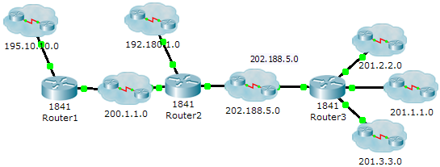
Advertising the Network
After selecting the routing protocol (e.g. RIP), the router needs to “advertise” all the subnets attached it.
For example, in the above networks:
Router3 has 4 subnets attached it
network 201.2.2.0, network 201.1.1.0, network 201.3.3.0, network 202.188.5.0
Router2 has 3 subnets attached it.
network 192.180.1.0, network 202.188.5.0, network 200.1.1.0
Router1 has 2 subnets attached it.
Network 200.1.1.0, network 195.10.10.0

Slide 52
IP Routing Rule #6
If there is a new subnet in the network, all the routers need to have the routes that point to that subnets.
If a subnet is being taken out of the network, all the routers need to erase destination network in the routing table that points to that subnet.
If the network is not EXPLICITLY informed on the addition of subnets, there is no way the routers of the network will have routes pointing to the new subnet.

Slide 53
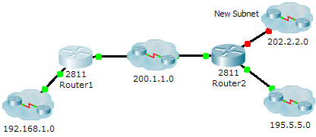
Example of IP Routing Rule #6
In dynamic routing if Router2 has not EXPLICITLY advertise the network of 202.2.2.0, Router1 will not no way to know the existence of the new subnet 202.2.2.0 which is attached to Router2.
Router1#show ip route
…
Gateway of last resort is not set
C 192.168.1.0/24 is directly connected, FastEthernet0/1
R 195.5.5.0/24 [120/1] via 200.1.1.2, 00:00:07, FastEthernet0/0
C 200.1.1.0/24 is directly connected, FastEthernet0/0

Slide 54
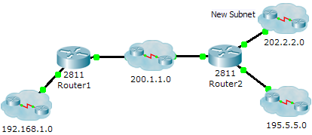
Example of IP Routing Rule #6
Router(config)#router rip
Router(config-router)#network 202.2.2.0
Router2 just need to advertise 202.2.2.0 (new subnets), since it has advertised the two older subnets to the network.
Router1#show ip route
…
Gateway of last resort is not set
C 192.168.1.0/24 is directly connected, FastEthernet0/1
R 195.5.5.0/24 [120/1] via 200.1.1.2, 00:00:07, FastEthernet0/0
C 200.1.1.0/24 is directly connected, FastEthernet0/0
R 202.2.2.0/24 [120/1] via 200.1.1.2, 00:00:27, FastEthernet0/0
new
entry

Slide 55
IP Routing Rules #7
Router must have a routing table with entries made of unique destination network address.
Data must refer to routing table in order to know where to go.
A route:
is the “road” from source to destination
Routing table is:
A road map and the road direction board of the data.
The mechanism to guide data travel from 1 LAN to another LAN
Routing table should have:
The destination networks addresses
The destination network subnet mask
The next hop (or gateway) for a particular destination network.
The outbound interface for a particular destination network.
A network metric
Last resort gateway or default gateway

Slide 56
Cisco Routing Table Example
Gateway IP (or Next Hop)
Unique destination network

Slide 57
Cisco Routing Table Explained (Top half)
The Codes section at the very top tells you how the router get the route
There are few ways a route can be obtained
C = connected (you set it)
S = Static (you set it too)
R, I, D, O = (from routing software, you need to configure this too)
Note the line “Gateway of last resort is not set”.
The gateway of last resort, also known as a default route, is where your router will send IP packets if there isn’t a match in the routing table.
After that, are the “routing table entries”

Slide 58
Routing Table Entry Explained - 1
R
A code indicating how the route entry was learned on this router. In this case, the R stands for RIP (a form of dynamic routing).
175.21.0.0/16
The network address and prefix length (number of bits set to 1 in the subnet mask) of the destination network.
[120
The administrative distance of the route.
/1]
The metric of the route specific to the routing protocol used to determine the route.
RIP uses hops as its metric. In this example, there is one router between this router and the destination.
Different routing protocols have different set of metrics

Slide 59
Routing Table Entry Explained - 2
via 10.10.10.1
The next-hop address (gateway) for the route.
This is the IP address that the packet will exit from the LAN in order for the packet to reach its destination.
00:00:18
The length of time since the route has been updated in the routing table. In this example, the route was updated 18 seconds ago.
Serial0
The interface the route was learned through.
This is also the interface the packet will be switched to in order for the packet to be forwarded toward its destination.

Slide 60
Windows XP Routing Table Example
C:\>route print
===========================================================================
Interface List
0x1 ........................... MS TCP Loopback interface
0x2 ...00 20 ed 78 85 31 ...... Realtek RTL8139 Family PCI Fast Ethernet NIC - Packet Scheduler Miniport
===========================================================================
===========================================================================
Active Routes:
Network Destination Netmask Gateway Interface Metric
0.0.0.0 0.0.0.0 192.168.19.254 192.168.19.31 30
127.0.0.0 255.0.0.0 127.0.0.1 127.0.0.1 1
192.168.19.0 255.255.255.0 192.168.19.31 192.168.19.31 30
192.168.29.0 255.255.255.0 192.168.19.200 192.168.19.31 30
192.168.19.31 255.255.255.255 127.0.0.1 127.0.0.1 30
192.168.9.255 255.255.255.255 192.168.19.31 192.168.19.31 30
224.0.0.0 240.0.0.0 192.168.19.31 192.168.19.31 30
255.255.255.255 255.255.255.255 192.168.19.31 192.168.19.31 1
Default Gateway: 192.168.19.254
===========================================================================

Slide 61
XP Routing Table Explained - 1
Windows XP routing table is displayed with the command “route print”
The Network Address and Netmask columns
show the values that are used to determine if the destination matches the routing table entry.
The Gateway Address and Interface columns
tell where the packet should be forward and then sent
Metric
shows how "expensive" it is to send the packet.

Slide 62
Windows XP Routing Table - 2
===========================================================================
Active Routes:
Network Destination Netmask Gateway Interface Metric
0.0.0.0 0.0.0.0 192.168.19.254 192.168.19.31 30
127.0.0.0 255.0.0.0 127.0.0.1 127.0.0.1 1
192.168.19.0 255.255.255.0 192.168.19.31 192.168.19.31 30
192.168.29.0 255.255.255.0 192.168.19.200 192.168.19.31 30
The first line of this routing table is the default route. 0.0.0.0 0.0.0.0
The second line is the loopback route.
The third line defines the range of addresses on the local network segment.
This shows that any address in the 192.168.19.0 Class C network should be found on the network segment connected to the interface with the address 192.168.19.31.
The fourth line defines the destination addresses of a remote network that should not be sent to the default gateway.
This shows that any address in the 192.168.29.0 Class C network should be sent to the gateway 192.168.19.200

Slide 63
Windows XP Routing Table - 3
192.168.19.31 255.255.255.255 127.0.0.1 127.0.0.1 30
192.168.19.255 255.255.255.255 192.168.19.31 192.168.19.31 30
224.0.0.0 240.0.0.0 192.168.19.31 192.168.19.31 30
255.255.255.255 255.255.255.255 192.168.19.31 192.168.19.31 1
Default Gateway: 192.168.19.254
===========================================================================
The fifth line is how a Microsoft routing table defines that 192.168.9.31 is an address for the local host.
The 255.255.255.255 netmask identifies that this route applies to only to packets addressed to the single address 192.168.19.31.
The 127.0.0.1 Gateway and Interface addresses pass all packets for this address to the local host.
The sixed entry lists the broadcast address for the local network.
This is another entry that is automatically added when an interface on a Windows TCP/IP system is assigned an IP address.
The seven line is the multi-cast address.
The eight line is the broadcast IP address used in protocols such as dhcp.

Slide 64
Linux Routing Table - 1
Displayed by commands either “route –e” or “netstat –nr”
Destination
The destination network or destination host.
Gateway
The gateway address or '*' if none set.
Genmask
The netmask for the destination net; '255.255.255.255' for a host destination and '0.0.0.0' for the default route.

Slide 65
Linux Routing Table - 3
Metrics
Same as Windows, indicating how “expensive” the route is.
Use
How many times that the routing entry has been used
IFace
The ethernet interface

Slide 66
Setting Static Routes in Windows XP and Linux
Some commands to set static routes in Windows XP, Linux, and Cisco

Slide 67
XP Commands for Static Route
> route ADD 157.0.0.0 MASK 255.0.0.0 157.55.80.1 METRIC 3 IF 2
destination^ ^mask ^gateway metric^ ^
Interface^
> route CHANGE 157.0.0.0 MASK 255.0.0.0 157.55.80.5 METRIC 2 IF 2
CHANGE is used to modify gateway and/or metric only.
> route PRINT
> route DELETE 157.0.0.0

Slide 68
Static Route example in Linux
Access individual computer host specified via network interface card eth1:
route add -host 123.213.221.231 eth1
Access ISP network identified by the network address and netmask using network interface card eth0:
route add -net 10.13.21.0 netmask 255.255.255.0 gw 192.168.10.254 eth0
Conversely, meaning deleting a route:
route del -net 10.13.21.0 netmask 255.255.255.0 gw 192.168.10.254 eth0
Specify default gateway to use to access remote network via network interface card eth0:
route add default gw 201.51.31.1 eth0

